Slide 1
SALES ANALYSIS

Slide 2
INTRODUCTION
Sales analysis is an essential process that enables businesses to track, evaluate, and improve their sales performance, customer satisfaction by leveraging structured data.It consist of five tables.
They are:
Customers: Stores customer details, including contact information.
Products: Maintains product details such as category, price, and stock.
Sales: Records transactions with total sales amount and date.
Sales Details: Tracks purchased products, quantities, and prices.
Payments: Manages payment methods and statuses.

Slide 3
OBJECTIVE
The objective of the above tables is to create a structured sales management database that efficiently stores and manages customer information, product details, sales transactions, payment records, and inventory. This schema ensures data integrity, enables easy tracking of sales trends, and supports better decision-making for business growth and customer management.

Slide 4

CREATING DATABASE
Create database sales_analysis

Slide 5
CREATE TABLES
Customers table:
CREATE TABLE Customers ( customer_id INT PRIMARY KEY AUTO_INCREMENT name VARCHAR(30) NOT NULL,
email VARCHAR(40) UNIQUE NOT NULL,
phone bigint UNIQUE,
address TEXT, created_at TIMESTAMP DEFAULT CURRENT_TIMESTAMP );

Slide 6
PRODUCTS TABLE
CREATE TABLE Products ( product_id INT PRIMARY KEY AUTO_INCREMENT,
name VARCHAR(30) NOT NULL,
category VARCHAR(20) NOT NULL,
price DECIMAL(10,2) NOT NULL,
stock INT NOT NULL,
created_at TIMESTAMP DEFAULT CURRENT_TIMESTAMP );

Slide 7
SALES TABLE
CREATE TABLE Sales ( sale_id INT PRIMARY KEY AUTO_INCREMENT,
customer_id INT,
total_amount DECIMAL(10,2) NOT NULL,
sale_date TIMESTAMP DEFAULT CURRENT_TIMESTAMP,
FOREIGN KEY (customer_id) REFERENCES Customers(customer_id) ON DELETE CASCADE ON UPDATE CASCADE
);

Slide 8
SALES_DETAILS TABLE
CREATE TABLE Sales_Details ( sale_detail_id INT PRIMARY KEY AUTO_INCREMENT,
sale_id INT,
product_id INT,
quantity INT NOT NULL,
price DECIMAL(10,2) NOT NULL,
FOREIGN KEY (sale_id) REFERENCES Sales(sale_id) ON DELETE CASCADE ,
FOREIGN KEY (product_id) REFERENCES Products(product_id)ON DELETE CASCADE);

Slide 9
PAYMENT TABLE
CREATE TABLE Payments ( payment_id INT PRIMARY KEY AUTO_INCREMENT, sale_id INT,
payment_method VARCHAR(50) NOT NULL,
payment_status VARCHAR(50) DEFAULT 'Pending’,
payment_date TIMESTAMP DEFAULT CURRENT_TIMESTAMP,
FOREIGN KEY (sale_id) REFERENCES Sales(sale_id) ON DELETE CASCADE);

Slide 10
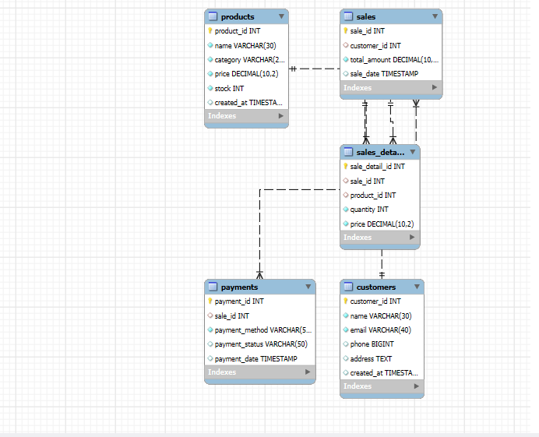
ER-DIAGRAM

Slide 11
RELATIONSHIPS
One-one:
sales
payments
One-many:
customers
sales
sales
Sales_details
products
Sales_details

Slide 12
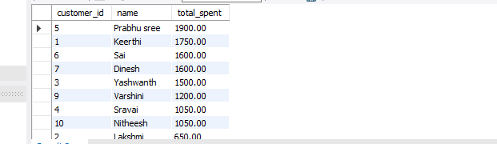
Find Total Sales Amount Per Customer
SELECT c.customer_id,
c.name,
SUM(s.total_amount) AS total_spent FROM Customers c JOIN Sales s ON c.customer_id = s.customer_id GROUP BY c.customer_id, c.name ORDER BY total_spent DESC;

Slide 13
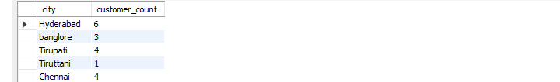
NUMBER OF CUSTOMERS IN EACH CITY
SELECT address AS city, COUNT(*) AS customer_count FROM Customers GROUP BY address;

Slide 14
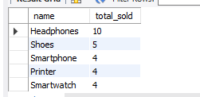
TOP 5 BEST SELLING PRODUCTS
SELECT p.name, SUM(sd.quantity) AS total_soldFROM Products pJOIN Sales_Details sd ON p.product_id = sd.product_idGROUP BY p.product_id, p.name ORDER BY total_sold DESCLIMIT 5;

Slide 15
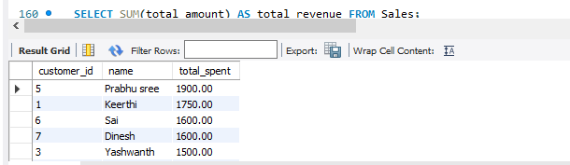
Total Revenue Generated
This query represents the total sales from all sales

Slide 16
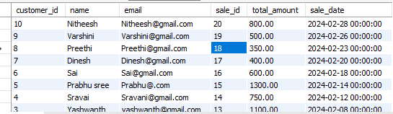
Retrieve All Customers and their purchases
SELECT c.customer_id, c.name, c.email, s.sale_id, s.total_amount, s.sale_date FROM Customers c LEFT JOIN Sales s ON c.customer_id = s.customer_id ORDER BY s.sale_date DESC;

Slide 17

Payment Status Report
SELECT payment_status, COUNT(*) AS total_paymentsFROM PaymentsGROUP BY payment_status;

Slide 18
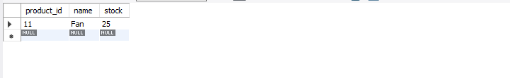
Find Stock of Products Below 30
SELECT product_id, name, stock FROM Products WHERE stock < 30;

Slide 19
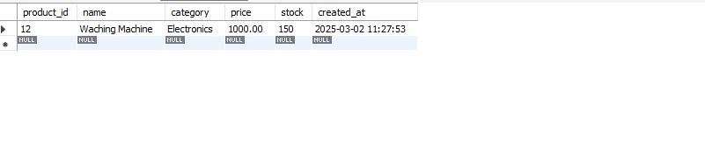
Find the most expensive product
SELECT * FROM Products ORDER BY price DESC LIMIT 1;

Slide 20
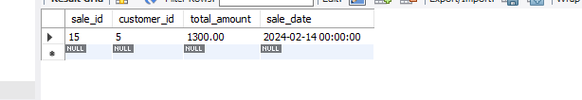
Find the largest sale transaction
SELECT * FROM Sales ORDER BY total_amount DESC LIMIT 1;

Slide 21

Total Quantity of Products Sold
This calculates the total number of products sold.
SELECT SUM(quantity) AS total_products_sold FROM Sales_Details;

Slide 22
CONCLUSION
The data analysis of these tables helps us understand how customers buy products, which products sell the most, how much money is made, and how payments are processed.
It shows who the best customers are, which items need restocking, and when sales are high.
This information helps businesses make better decisions, manage stock properly, and keep customers happy.

Slide 23
THANK YOU

